Slide 1
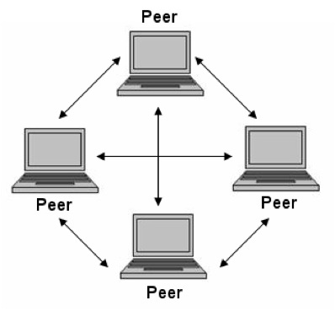
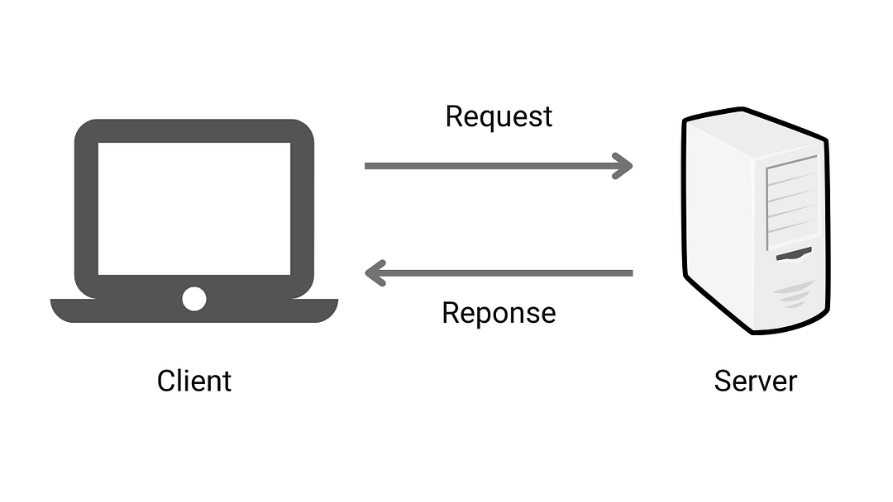
Client Server and Peer-to-Peer Models
A client server and a Peer-to-Peer Models are two different architectures for designing networks and distributed systems.
Even though they function differently, they can actually work together in specifics enviroments.
Client Server model:
In this architecture, multiple clients (devices or software) request and receive services from a centralized server
Peer-to-Peer model:
In this architecture, each node,
or “peer”, is directly enabled
to share resources among
peers without the need
for centralized coordination.
It is often used for file
sharing, communications,
and collaborative tasks.
Image credit: enjoyalgorithms.com
Image credit: definicionabc.com

Slide 2
Difference between these two architectures
As we see from the images above
In the Client Server Model:
The Client:
Requests services or resources
The Server:
Provides resources and services.
Manages all processes and data storage.
Sends output back to the client
In the Peer-to-Peer Model
Each peer can be both a server and a client:
Requests services or resources.
Provides resources and services.
Manages processes and data storage.
Sends output back to the others.

Slide 3
Advantages and disadavantages
Obviously these architectures have several advantages and disadavantages:
Client Server Architecture :
Advantages:
Centralized Management
Security
Reliability
Scalability
Easier Backup & Data Management
Peer-to-Peer Architecture:
Disadvantages:
Single Point of Failure
Cost
Network Traffic
Dependence on Server
Advantages:
Decentralized
Cost-Effective
Scalability
Redundancy
Efficiency
Disadvantages:
Security
Limited Control
Network Congestion
Complexity in Management
In summary:
Client-Server is best for environments that require centralized control, security, and reliable performance, but it can suffer from a single point of failure and high costs.
Peer-to-Peer is more cost-effective, scalable, and resilient, but it can be less secure and harder to manage due to its decentralized nature.

Slide 4
Implementazione del modello P2P su zoom
L'implementazione del modello peer-to-peer (P2P) su Zoom è pensata per migliorare l'efficienza della comunicazione tra partecipanti, riducendo la latenza e migliorando la qualità delle videochiamate.
La logica di base è che, quando possibile, i dati (audio, video e messaggi) vengano trasmessi direttamente tra i partecipanti, senza passare attraverso i server di Zoom. Questo modello è usato principalmente nelle riunioni con due partecipanti.
A livello tecnico ciò avviene:
Connessione diretta tra i partecipanti :
Quando due utenti si connettono a una riunione Zoom, il sistema cerca prima di stabilire una connessione diretta tra di loro, utilizzando il modello P2P.
La comunicazione tra i dispositivi avviene direttamente senza che i dati passino per un server centrale di Zoom. Questo avviene tramite i protocollo WebRTC o altre tecnologie P2P.
Tecnologie di Supporto: NAT (Network Address Translation) Traversal:
Il NAT è un meccanismo che mappa gli indirizzi IP privati agli indirizzi pubblici di internet, creando difficoltà nella connessione P2P (se dietro ci sono firewall o router).
Per ovviare a questo problema Zoom utilizza Il NAT Trasversal come STUN e TURN che permettono di stabilire e mantenere una connessione diretta anche quando i partecipanti sono dietro firewall complessi o NAT.

Slide 5
Crittografia e sicurezza:
Anche nel modello P2P, la crittografia è fondamentale per garantire la sicurezza dei dati. Zoom applica la crittografia AES-256 per proteggere le comunicazioni tra i partecipanti.Quando la crittografia end-to-end (E2EE) è attivata, i dati sono crittografati in modo che solo i partecipanti possano decifrarli. Anche i server di Zoom non hanno accesso ai contenuti della comunicazione, dato che non gestiscono il flusso di dati P2P in modo diretto.
Qualità della connessio e backup:
Se la connessione P2P fallisce (es: problematiche di rete o di NAT complessi), Zoom automaticamente a una connessione server, che gestisce la comunicazione, migliorando la robustezza e la compatibilità in situazioni complesse.

Slide 6
Implementations Enviroments
These architectures have revolutionized communication between computers and the way we interact with digital services nowadays.
For example the famous app and web platform Spotify uses the client-server model.
Spotify History:
Spotify was founded in 2006 in Stockholm, Sweden, by Daniel Ek and Martin Lorentzon and was released in 2008. The idea behind this platform are to curb online piracy, the accessibility to listen music without additional costs to download music files and, unlike the traditional music industry the artists are paid based on every song sold.

Slide 7
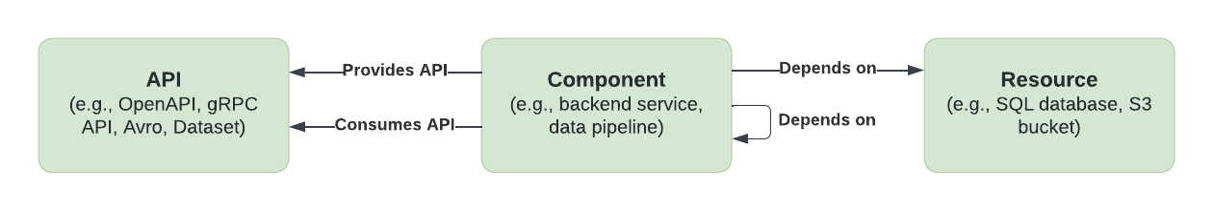
The Spotify System Model
To communicate through the software and use the catalog, Spotify presented its own System Model based on various entities and abstraction, the three main ones are:
APIs: the boundaries set between multiple components of the infrasctuture that define the interface between them
Components: Certain instances of a given software (for example, a website, data pipeline, library, etc.).
Resources: The backend infrastructure behind each component (database, storage bucket, etc.)
Image credit: engineering.atspotify.com
Also Spotify is based entirely on Microservices architecture that guarantees scalability and flexibility to enabling multiple services on differents platforms and devices.

Slide 8
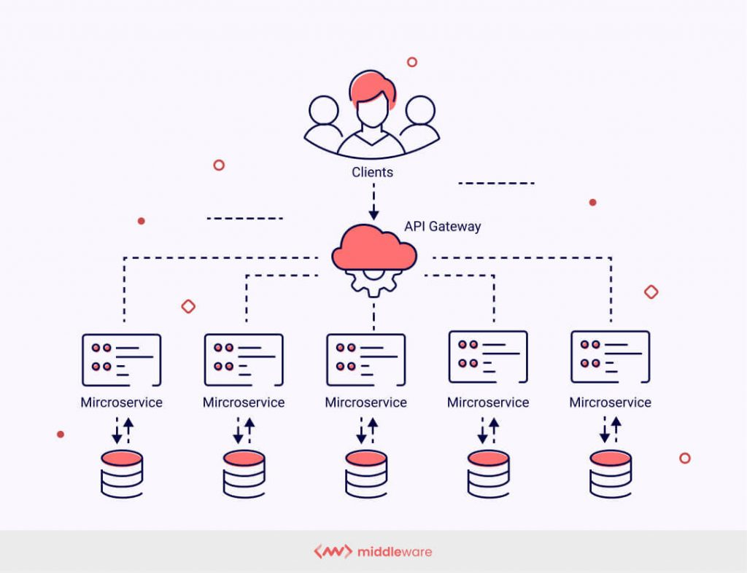
Understanding Microservice Architecture on Spotify
This kind of architecture allows to split the heavy parts of the application into smaller parts, each one being indipendant from the others and delivering its own functionality.
The devices and the digital platforms interact with Spotify through APIs (Application Programming Interfaces) that allow access to functionalities, such as music playback or playlist synchronization.
Many microservices are developed simultaneously to solve users’ problems independently and internally communicate with other services.
They are largely used to develop and deploy heavy applications.
Image credit: middleware.io

Slide 9
Microservice architecture in Spotify
The backend of Spotify needs hundreds of services, most tiny and straightforward, but they must be served in run-time without delay. To provide these hundreds of services, Spotify’s technical team deployed a microservices-based architecture.
Services are usually written in Python and/or Java, with few exceptions.
A highly specialized backend service called ‘access point’ is constantly in touch with various clients for swift and precise communication. The protocol, which enabled seamless communication between the clients and the ‘access point,’ has been built by Spotify engineers and hasn’t been made public. Spotify’s Software infrastructure heavily depends on Debian, while open-source software is preferred for various activities.

Slide 10
References
K. Varshneya, 2022, Decoding Software Architecture Of Spotify: How Microservices Empowers Spotify.Teachaheadcorp .https://www.techaheadcorp.com/blog/decoding-software-architecture-of-spotify-how-microservices-empowers-spotify/
R. Kalman et. J. Wallin, 2022, Software Visualization — Challenge, Accepted. Spotify Engineering. https://engineering.atspotify.com/2022/07/software-visualization-challenge-accepted/
Spotify Engineering, 2013, Backend infrastructure at Spotify. Spotify Engineering. https://engineering.atspotify.com/2013/03/backend-infrastructure-at-spotify/

